Slide 1
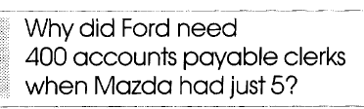
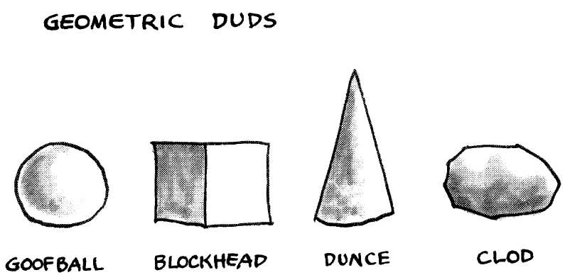
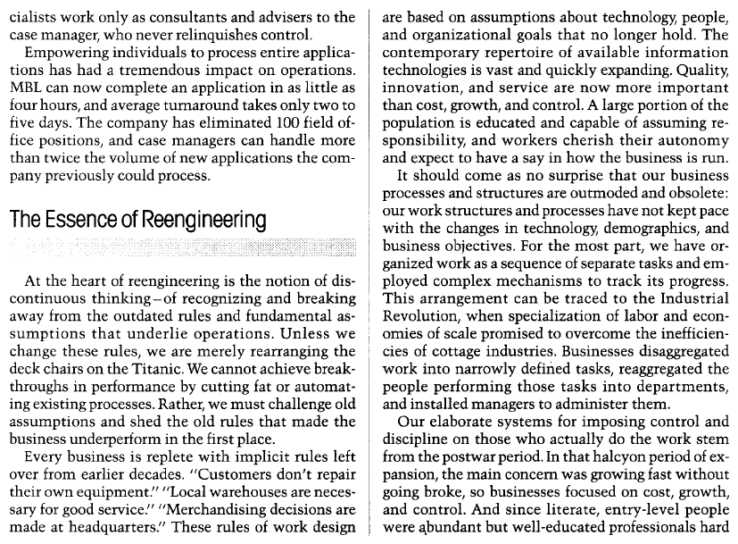
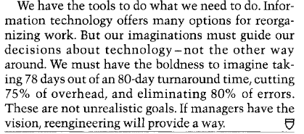








“Reengineering work: don’t automate, obliterate.” By Michael hammer
Reengineering requires looking at the fundamental processes of the business from a cross-functional perspective
The reengineering team must keep asking Why and What-if? Why do we need a manager’s signature? Do these reports need to be printed?
Reengineering strives for dramatic levels of improvement
IT and expert systems can capture and process data. But only supply limited knowledge to enable people to make decisions [now they do].
Question: why does Tesla not have any flagship stores like other car dealers?
Principals of reengineering
Organize around outcomes and not tasks
Have those who use the output of the process perform the process
Subsume information-processing work into the actual work that produces the information. in the past, orgs didn’t trust the people…
Link parallel activities instead of integrating their results
Put the decision point where the work is performed and build control into the process <not a department>
Capture information once and at the source
Imagination must guide our decisions.
It304.wk2.d2.2022
Lecture notes
1 of 2

Slide 2
